Slide 1
Distributions

Slide 2
Motivation
Overview of most common distributions, widely used to describe different types of events.
The form of the distribution can vary depending on the nature and complexity of the phenomenon that we describe.
Discrete and continuous distributions.

Slide 3
Discrete distributions
Bernoulli
Binomial
Poisson

Slide 4
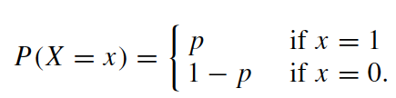
Bernoulli distribution
Useful when there are only two possible outcomes: e.g. whether a hurricane hits an island or not, whether a student passes a course or not.
If the event occurs, then it is coded as X=1; otherwise, X=0.
Assume that the event of interest occurs with probability p. Then the event does not occur with probability q=1-p.

Slide 5
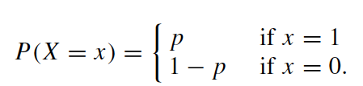


Bernoulli distribution

Slide 6

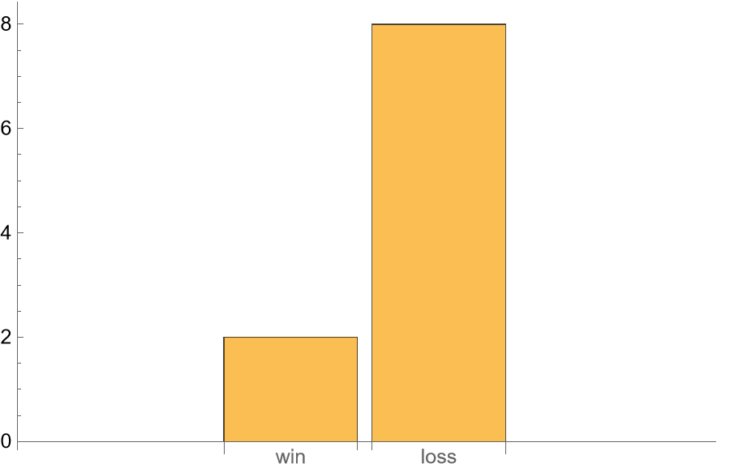
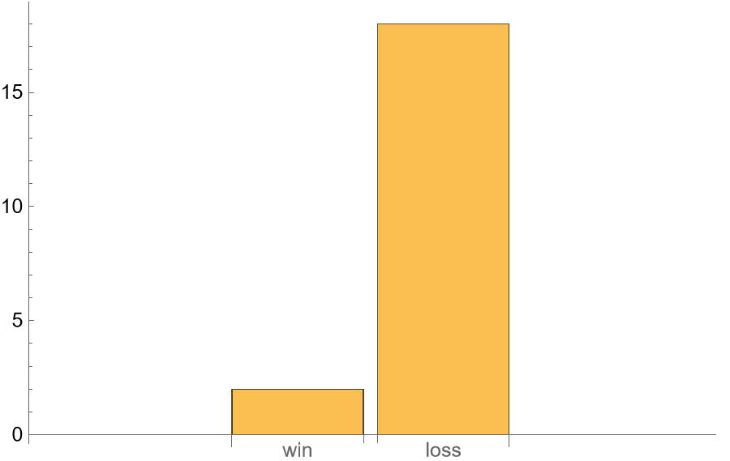

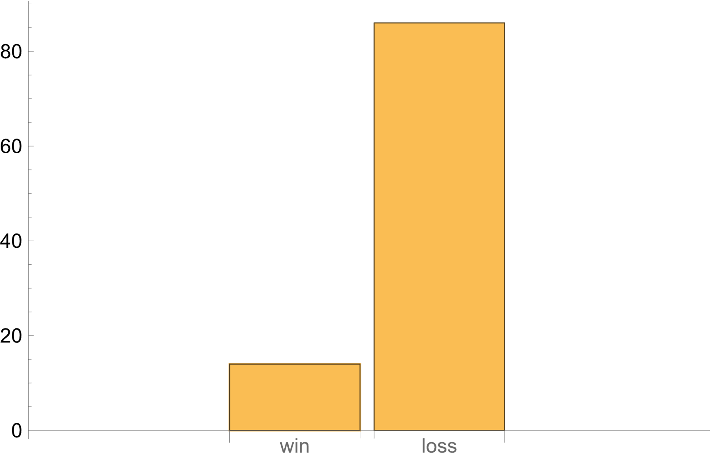
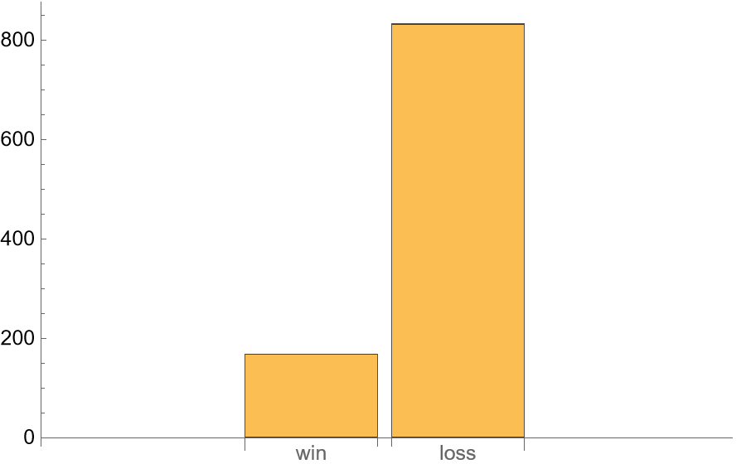
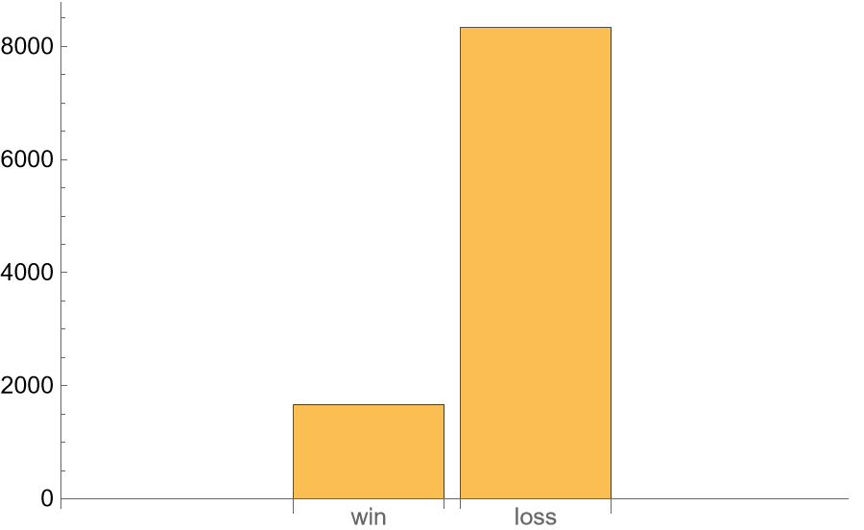
Bernoulli Distribution: example
Rolled 10 times
80%
Win: 6
Loss: 1, 2, 3, 4, 5
20%
Rolled 20 times
Rolled 50 times
Rolled 100 times
85%
88%
80%
15%
22%
20%
83.2%
83.36%
Rolled 1000 times
Rolled 10000 times
16.8%
16.64%

Slide 7
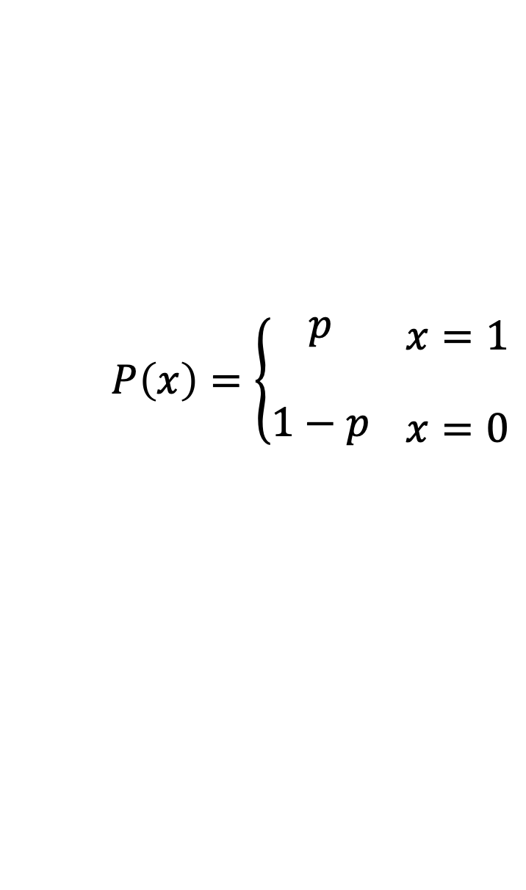

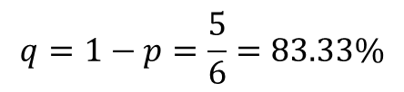
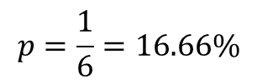
Bernoulli Distribution: example
Win: 6
Loss: 1, 2, 3, 4, 5
$$q=1−p=\frac{5}{6}=83.33\%$$
$$X\sim Bernoulli(p)$$
$$P\left(x\right)=\left\{\begin{matrix}\begin{aligned}p \\ \end{aligned} \\ 1−p\end{matrix} \right.\begin{matrix}\begin{aligned}x=1 \\ \end{aligned} \\ x=0\end{matrix}$$
$$p=\frac{1}{6}=16.66\%$$
X
X=1
(win)
X=0
(Loss)
83.2%
83.36%
Rolled 1000 times
Rolled 10000 times
16.8%
16.64%

Slide 8
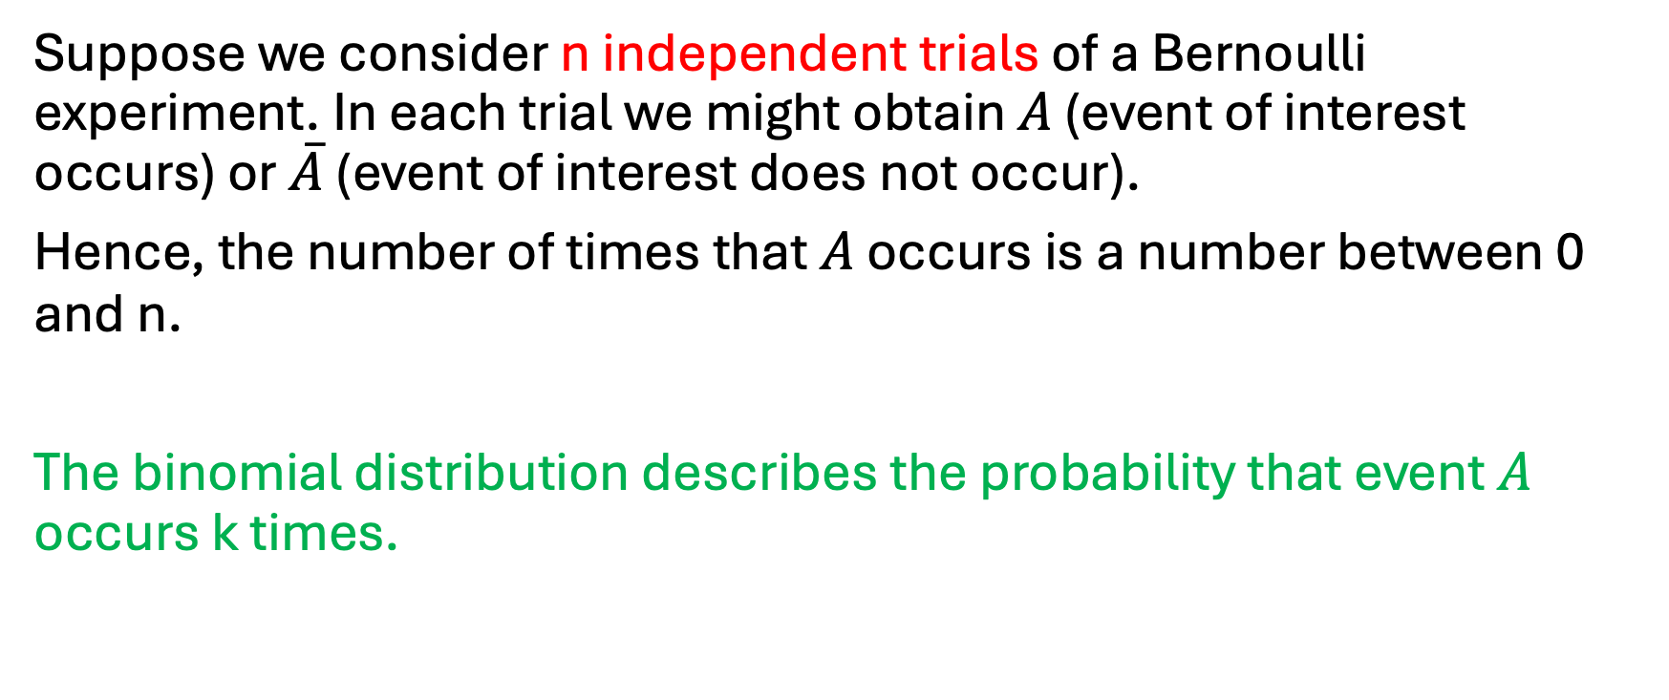
Binomial distribution
Suppose we consider n independent trials of a Bernoulli experiment. In each trial we might obtain $A$ (event of interest occurs) or $\overline{A}$ (event of interest does not occur).
Hence, the number of times that $A$ occurs is a number between 0 and n.
The binomial distribution describes the probability that event $A$ occurs k times.

Slide 9
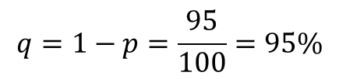
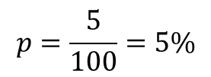
Example:
Five percent of all smartphones manufactured by a large electronics company are defective. A quality control inspector randomly selects three smartphones from the production line. What is the probability that exactly one of these three smartphones is defective?
Bernoulli Experiment: pick one phone at random
$$q=1−p=\frac{95}{100}=95\%$$
$$p=\frac{5}{100}=5\%$$
X
X=1
(defective)
X=0
(good)

Slide 10



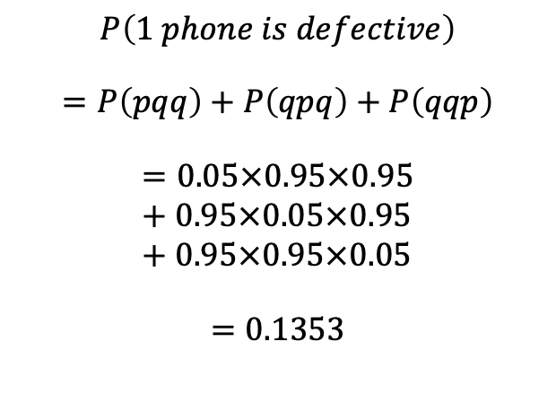




















Binomial Distribution
Five percent of all smartphones manufactured by a large electronics company are defective. A quality control inspector randomly selects three smartphones from the production line. What is the probability that exactly one of these three smartphones is defective?
$$Number of defective phones≡Random number X (0,1,2,3)$$
$$P\left(X=1\right)=?$$
$p=5\%=0.05≡$ probability of selecting a defective phone
Bernoulli Distribution
$q=95\%=0.95≡$ probability of selecting a good phone
First
phone
Second
phone
Third
phone
$$P\left(1 phone is defective\right)$$
$$=P\left(pqq\right)+P\left(qpq\right)+P\left(qqp\right)$$
$$=0.05×0.95×0.95+0.95×0.05×0.95+0.95×0.95×0.05$$
$$=0.1353$$
$$p$$
$$ppp$$
$$p$$
$$q$$
$$ppq$$
$$p$$
$$pqp$$
$$p$$
$$q$$
$$q$$
$$pqq$$
$$p$$
$$qpp$$
$$q$$
$$p$$
$$qpq$$
$$q$$
$$p$$
$$qqp$$
$$q$$
$$q$$
$$qqq$$

Slide 11
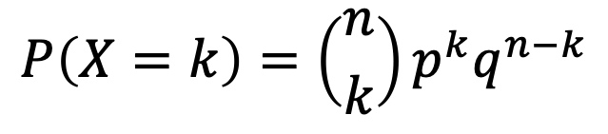
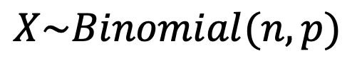
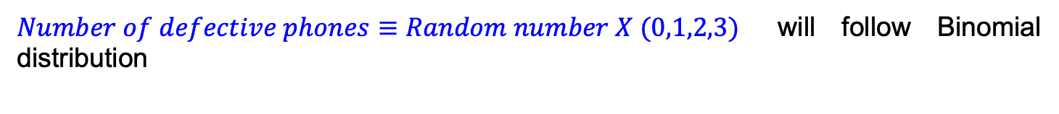
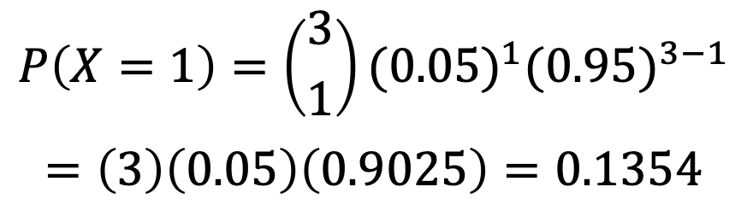
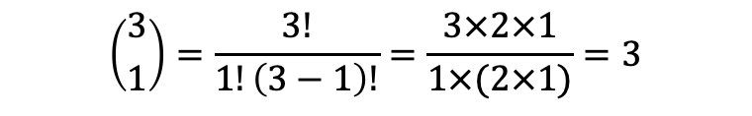
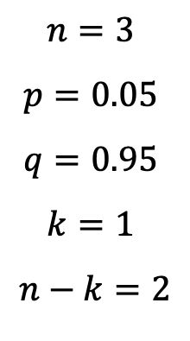
Binomial Distribution
Five percent of all smart phones manufactured by a large electronics company are defective. A quality control inspector randomly selects three smart phones from the production line. What is the probability that exactly one of these three smart phones is defective?
$Number of defective phones≡Random number X (0,1,2,3)$ will follow Binomial distribution
$$X\sim Binomial(n,p)$$
$$P\left(X=k\right)=\left({n \atop k}\right)p^{k}q^{n−k}$$
Binomial distribution:
$$n=3$$
$$p=0.05$$
$$q=0.95$$
$$k=1$$
$$n−k=2$$
$$P\left(X=1\right)=\left({3 \atop 1}\right){{(0.05)}^{1}(0.95)}^{3−1}$$
$$=\left(3\right)\left(0.05\right)\left(0.9025\right)=0.1354$$
$$\left({3 \atop 1}\right)=\frac{3!}{1!\left(3−1\right)!}=\frac{3×2×1}{1×(2×1)}=3$$

Slide 12
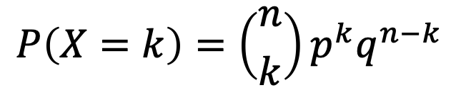
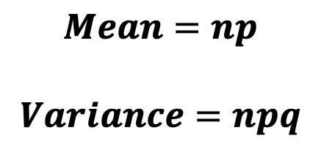

Binomial Distribution
Five percent of all smart phones manufactured by a large electronics company are defective. A quality control inspector randomly selects three smart phones from the production line. What is the probability that exactly one of these three smart phones is defective?
$Number of defective phones≡Random number X (0,1,2,3)$ will follow Binomial distribution
$$X\sim Binomial(n,p)$$
According to Binomial distribution:
$$P\left(X=k\right)={\left({n \atop k}\right)p}^{k}q^{n−k}$$
$$P\left(X\right)$$
0.85
$$Mean=np$$
$$Variance=npq$$
0.13
0.007
0.0001
X
X=0
X=1
X=2
X=3

Slide 13
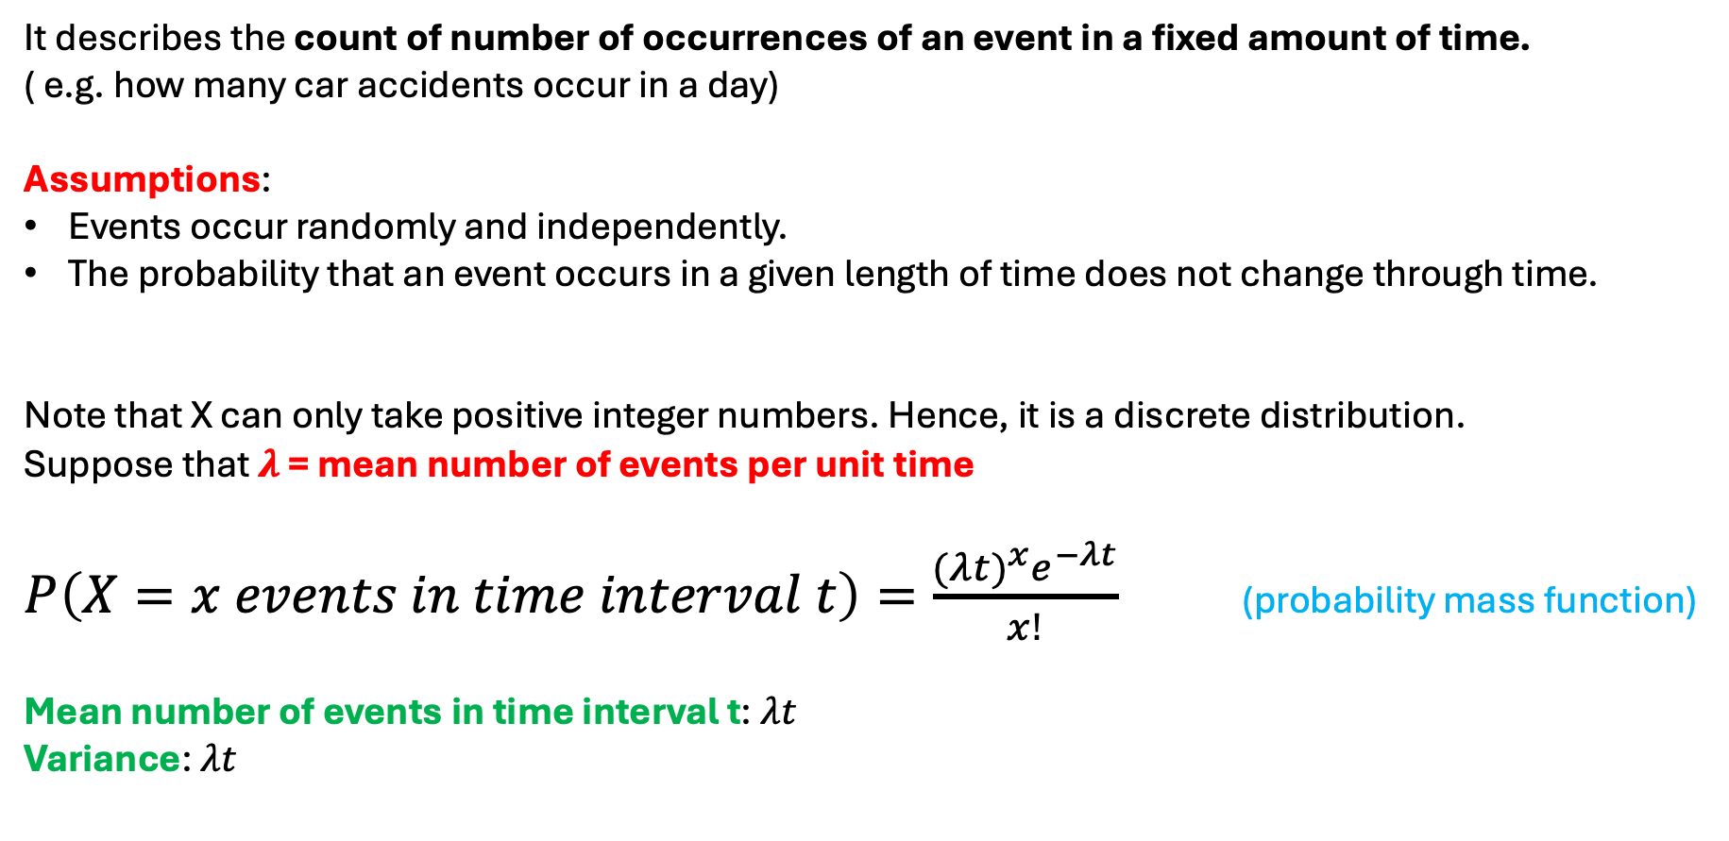
Poisson distribution
It describes the count of number of occurrences of an event in a fixed amount of time.
( e.g. how many car accidents occur in a day)
Assumptions:
Events occur randomly and independently.
The probability that an event occurs in a given length of time does not change through time.
Note that X can only take positive integer numbers. Hence, it is a discrete distribution.
Suppose that $λ$ = mean number of events per unit time
$P\left(X=x events in time interval t\right)=\frac{{(λt)}^{x}e^{−λt}}{x!}$ (probability mass function)
Mean number of events in time interval t: $λt$
Variance: $λt$

Slide 14
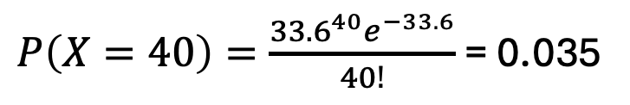
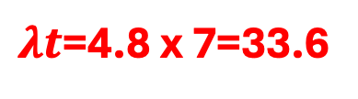
Example
If there is an average of 4.8 fatal car accidents per day in the UK, what is the probability that there are 40 fatal car accidents in 1 week in the UK?
$λt$=4.8 x 7=33.6
$P\left(X=40\right)=\frac{{33.6}^{40}e^{−33.6}}{40!}$ = 0.035

Slide 15
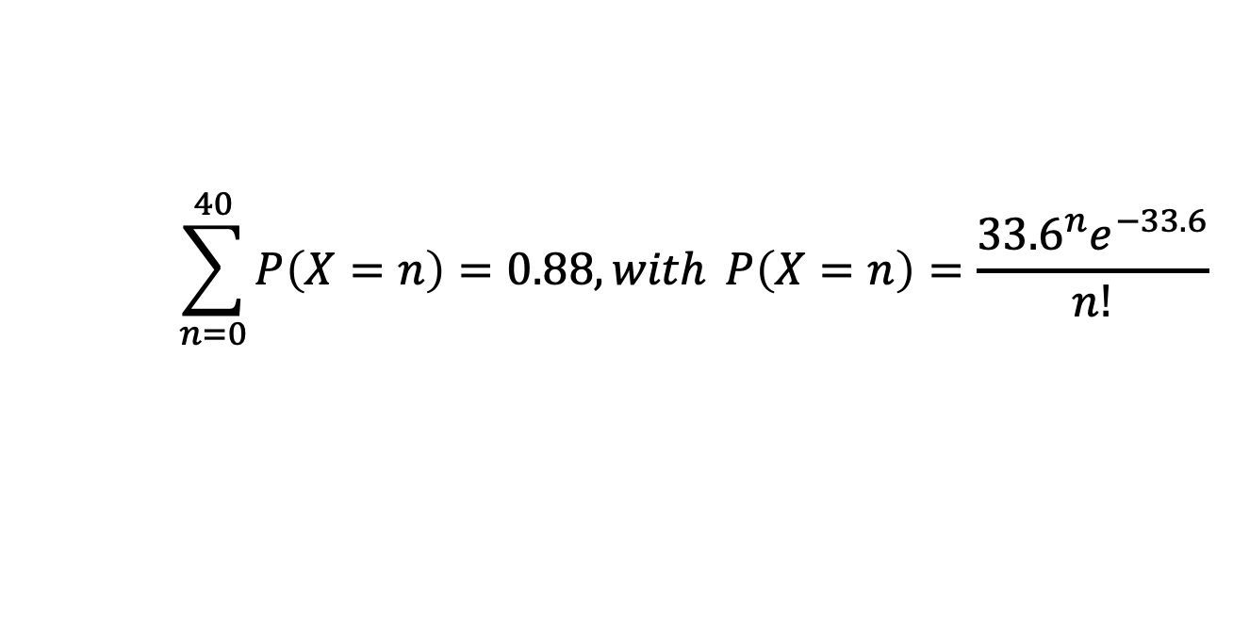
Example
If there is an average of 4.8 fatal car accidents per day in the UK, what is the probability that there are more than 40 fatal accidents in 1 week in the UK?
$$\sum_{n=0}^{40}{P\left(X=n\right)=0.88, with }P\left(X=n\right)=\frac{{33.6}^{n}e^{−33.6}}{n!}$$

Slide 16
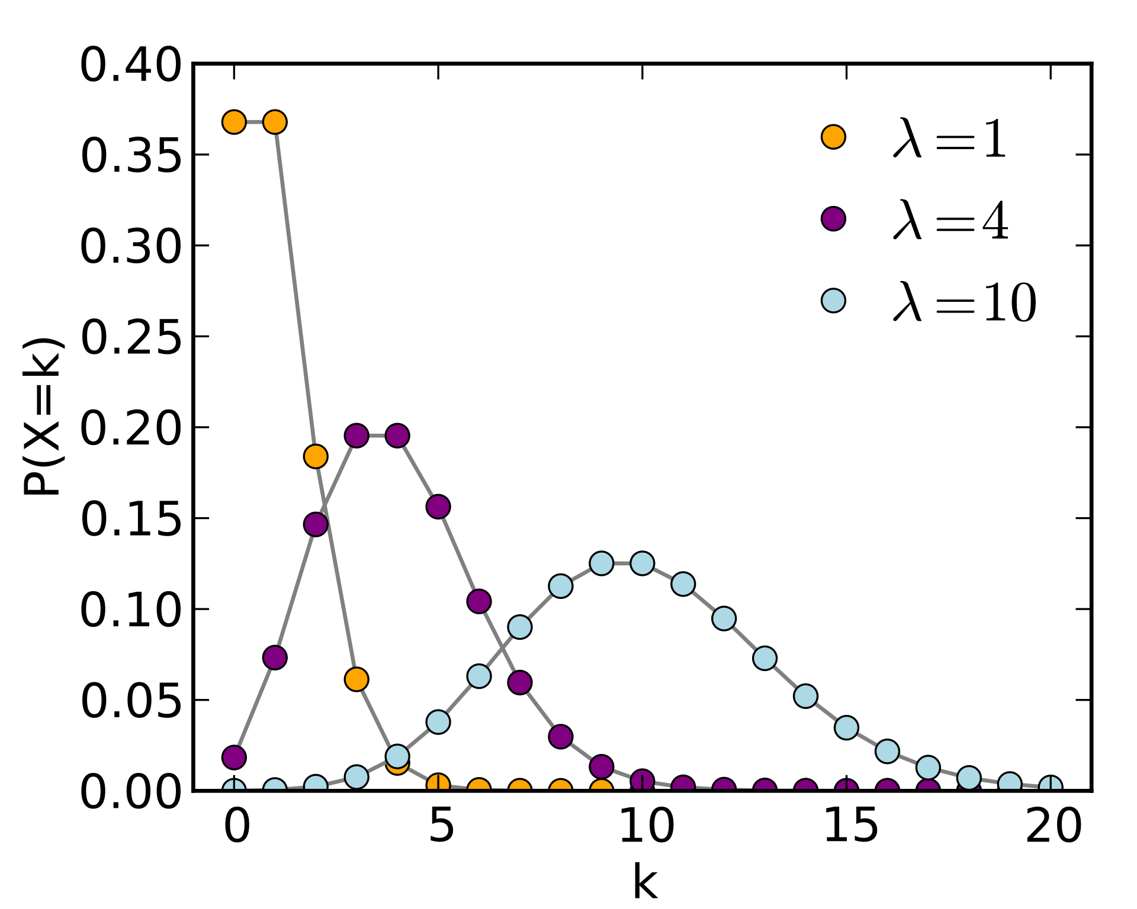

Poisson distribution for different values of $λ (t=1)$
Figure from Wikipedia.

Slide 17
Continuous distributions
Uniform
Normal
Exponential
Lognormal

Slide 18
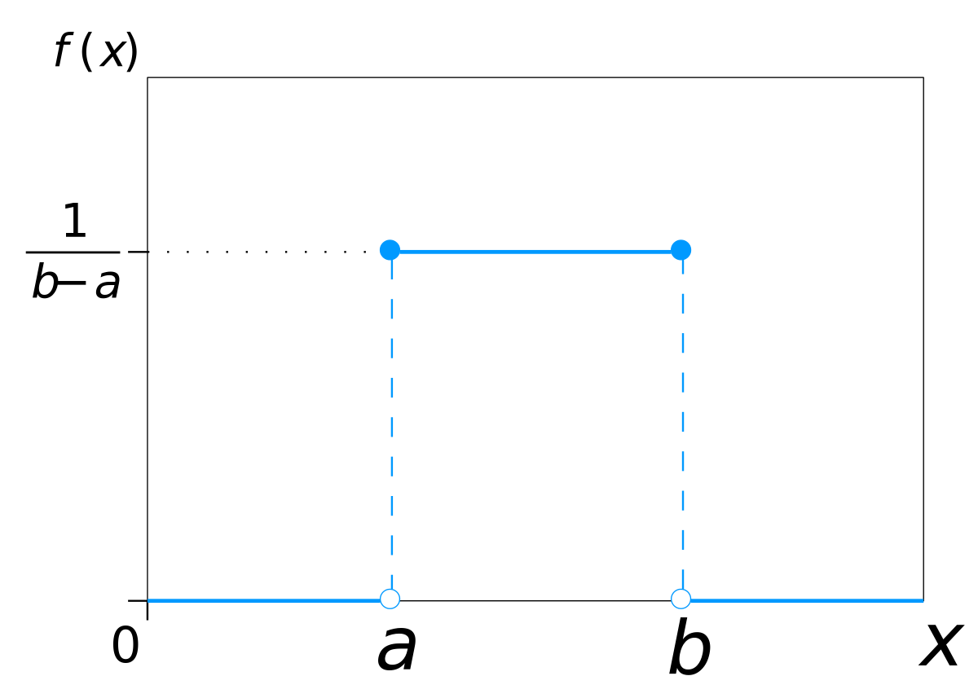

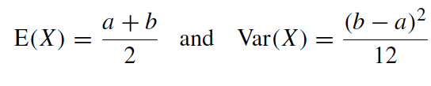

Uniform distribution
A continuous variable $X$ is uniformly distributed in the interval $[a,b]$ if its probability density function is as follows:
(remember example of waiting time at bus stop)

Slide 19
Normal or Gaussian distribution
One of the most important distributions used in statistics.
Name given by Carl Friedrich Gauss (1777-1855), a German mathematician, astronomer , geodesist and physicist.
Gauss observed that the geodesy and astronomy measurements deviate from their true value in a symmetric way.

Slide 20




Normal or Gaussian distribution
Notation to indicate that the random variable $X$ is normally distributed

Slide 21
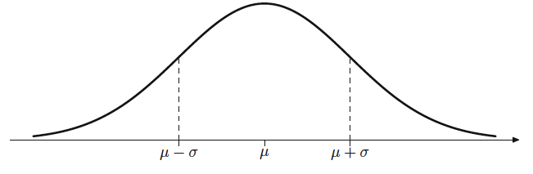
Normal or Gaussian distribution

Slide 22
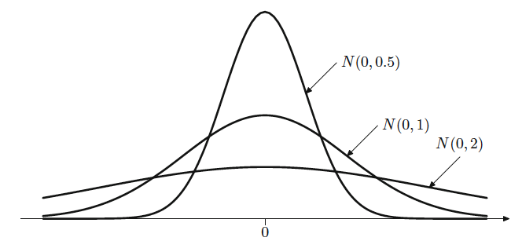
Normal or Gaussian distribution

Slide 23

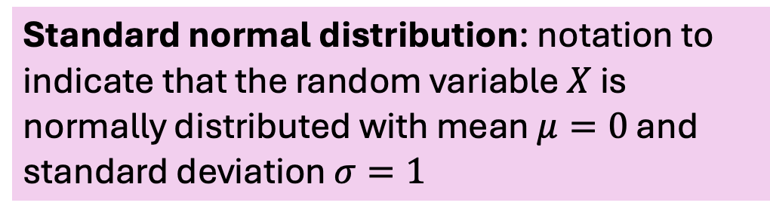

Normal or Gaussian distribution
Notation to indicate that the random variable $X$ is normally distributed with mean $μ$ and standard deviation $σ$
Standard normal distribution: notation to indicate that the random variable $X$ is normally distributed with mean $μ=0$ and standard deviation $σ=1$

Slide 24
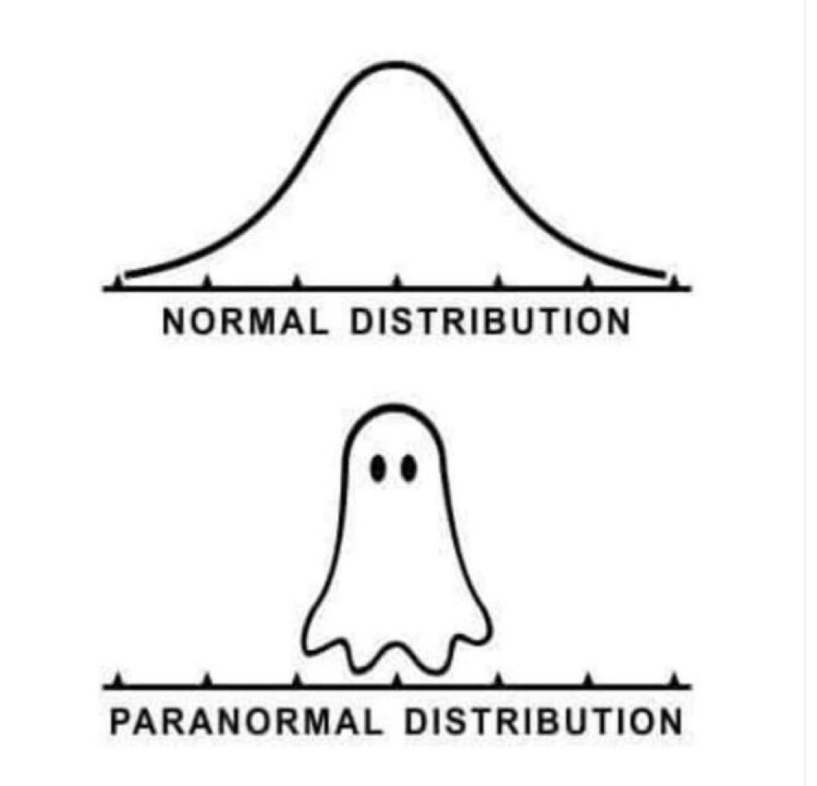

Slide 25


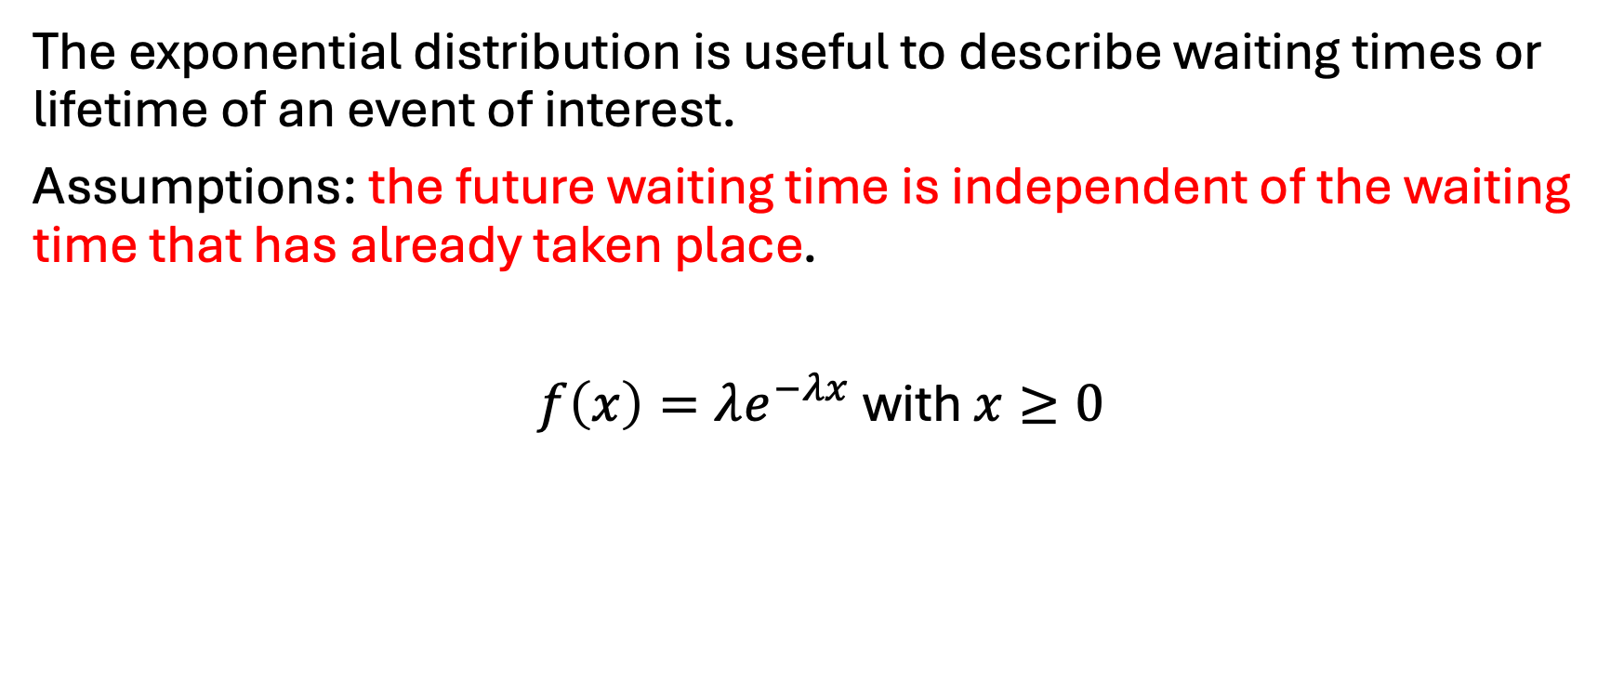
Exponential distribution
The exponential distribution is useful to describe waiting times or lifetime of an event of interest.
Assumptions: the future waiting time is independent of the waiting time that has already taken place.
$f\left(x\right)=λe^{−λx}$ with $x≥0$
(notation)

Slide 26

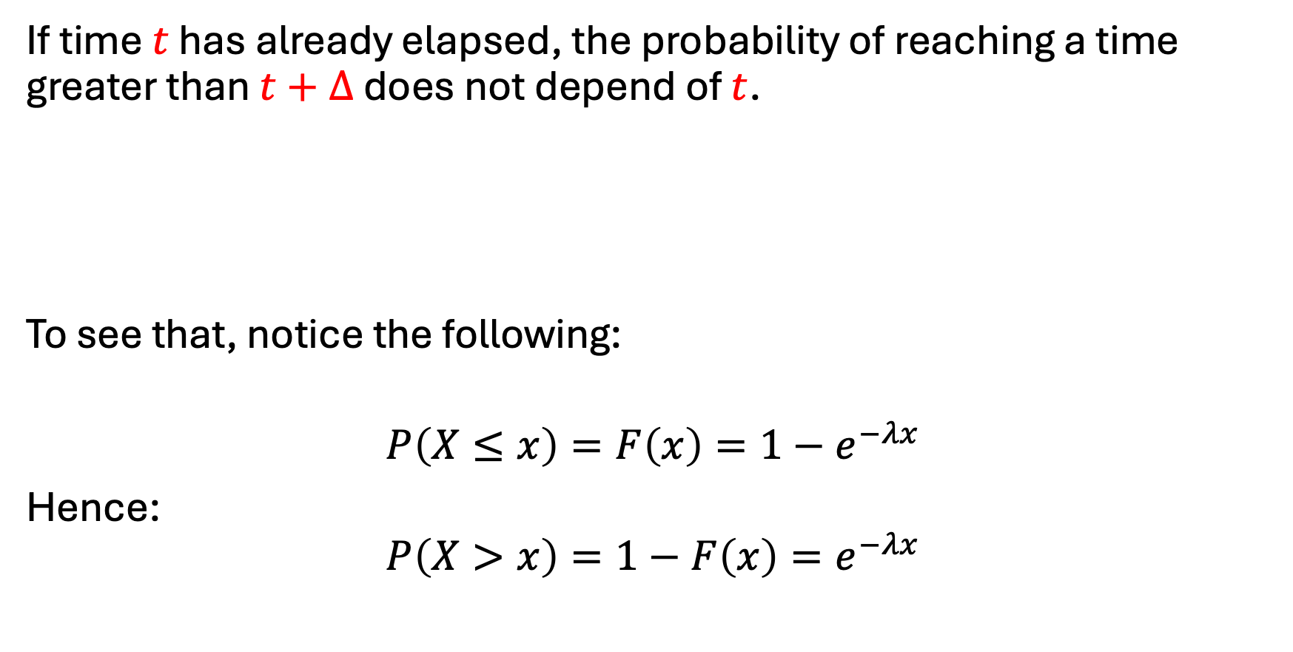
Exponential distribution: memoryless
If time $t$ has already elapsed, the probability of reaching a time greater than $t+Δ$ does not depend of $t$.
To see that, notice the following:
$$P\left(X≤x\right)=F\left(x\right)=1−e^{−λx}$$
Hence:
$$P\left(X>x\right)=1−F\left(x\right)=e^{−λx}$$
CDF

Slide 27
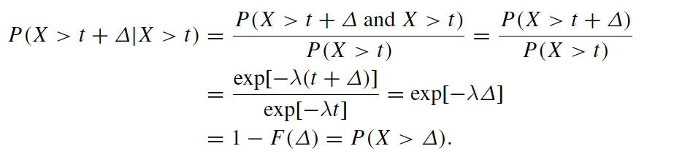
Exponential distribution: memoryless

Slide 28
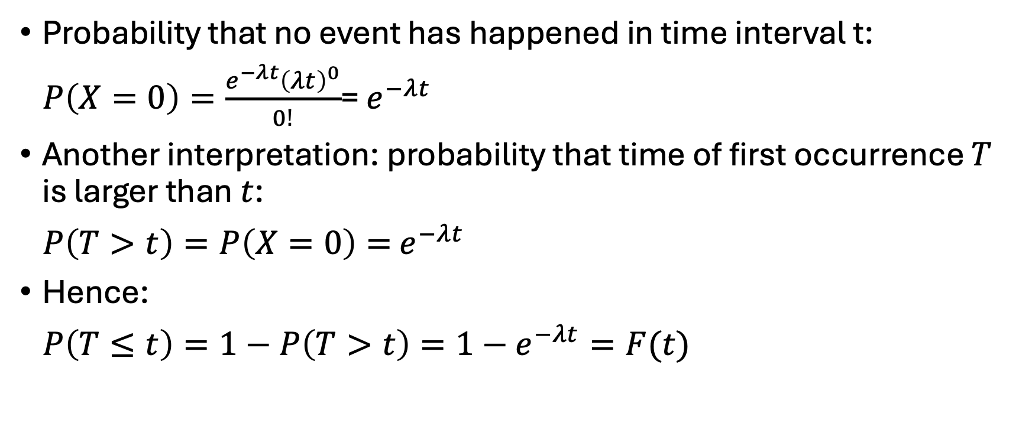
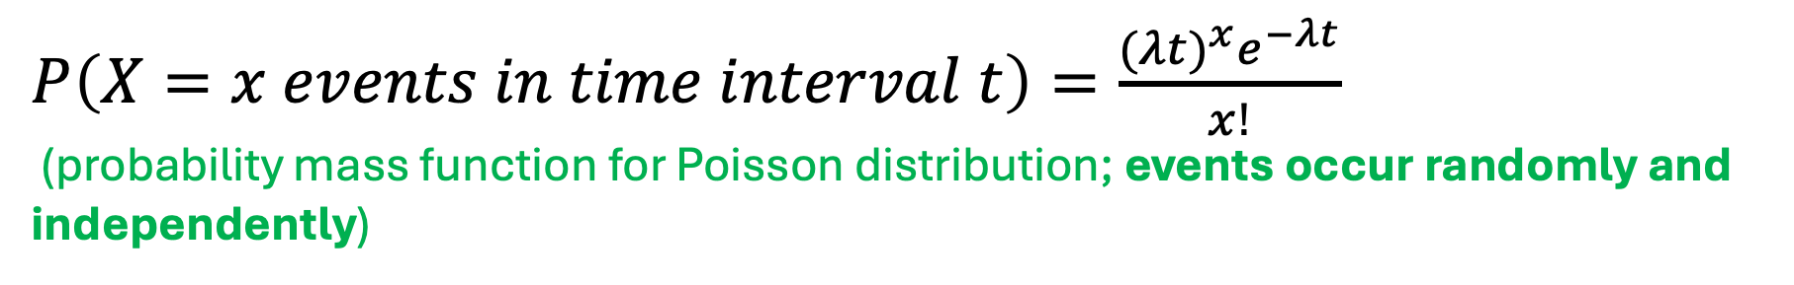
Relationship between Poisson and exponential distributions
$P\left(X=x events in time interval t\right)=\frac{{(λt)}^{x}e^{−λt}}{x!}$
(probability mass function for Poisson distribution; events occur randomly and independently)
Probability that no event has happened in time interval t:
$P\left(X=0\right)=\frac{e^{−λt}{\left(λt\right)}^{0}}{0!}$= $e^{−λt}$
Another interpretation: probability that time of first occurrence $T$ is larger than $t$:
$P\left(T>t\right)=P\left(X=0\right)=$ $e^{−λt}$
Hence:
$P\left(T≤t\right)=1−P\left(T>t\right)=1−$ $e^{−λt}=F(t)$
cumulative distribution function
of exponential distribution

Slide 29

Applying the fundamental theorem of calculus:
$$\frac{dP\left(T≤t\right)}{dt}=\frac{dF(t)}{dt}=f\left(t\right)=λe^{−λt}$$
PDF of waiting times between events in a Poisson process
is the exponential distribution

Slide 30
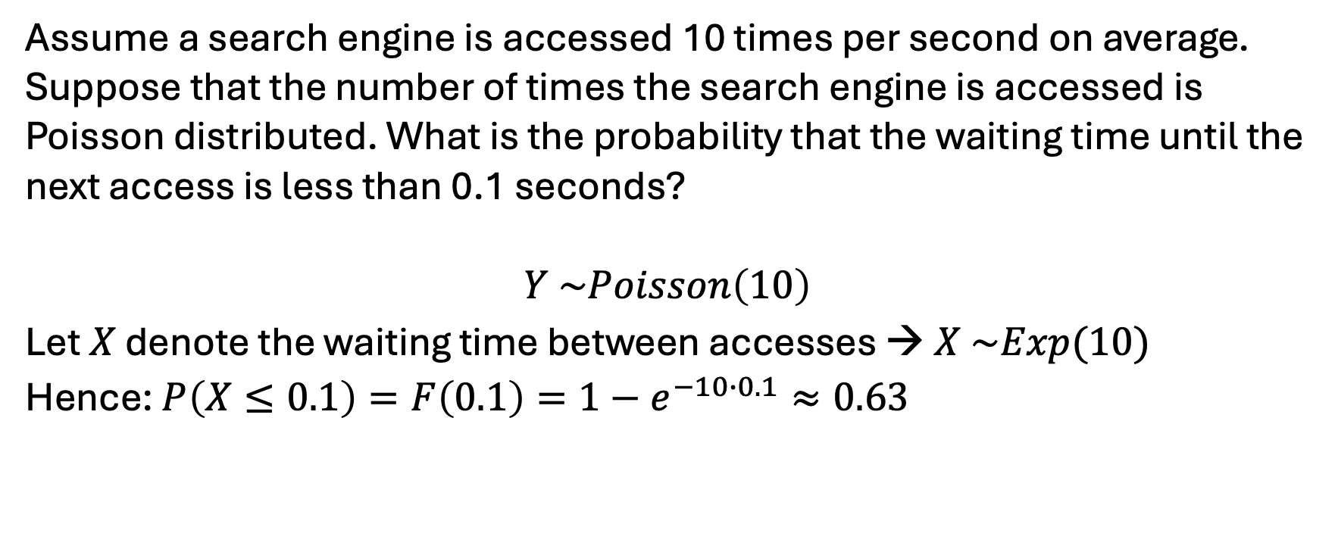
Example
Assume a search engine is accessed 10 times per second on average. Suppose that the number of times the search engine is accessed is Poisson distributed. What is the probability that the waiting time until the next access is less than 0.1 seconds?
$$Y \sim Poisson\left(10\right)$$
Let $X$ denote the waiting time between accesses →$X \sim Exp(10)$
Hence: $P\left(X≤0.1\right)=F\left(0.1\right)=1−e^{−10∙0.1}≈0.63$

Slide 31
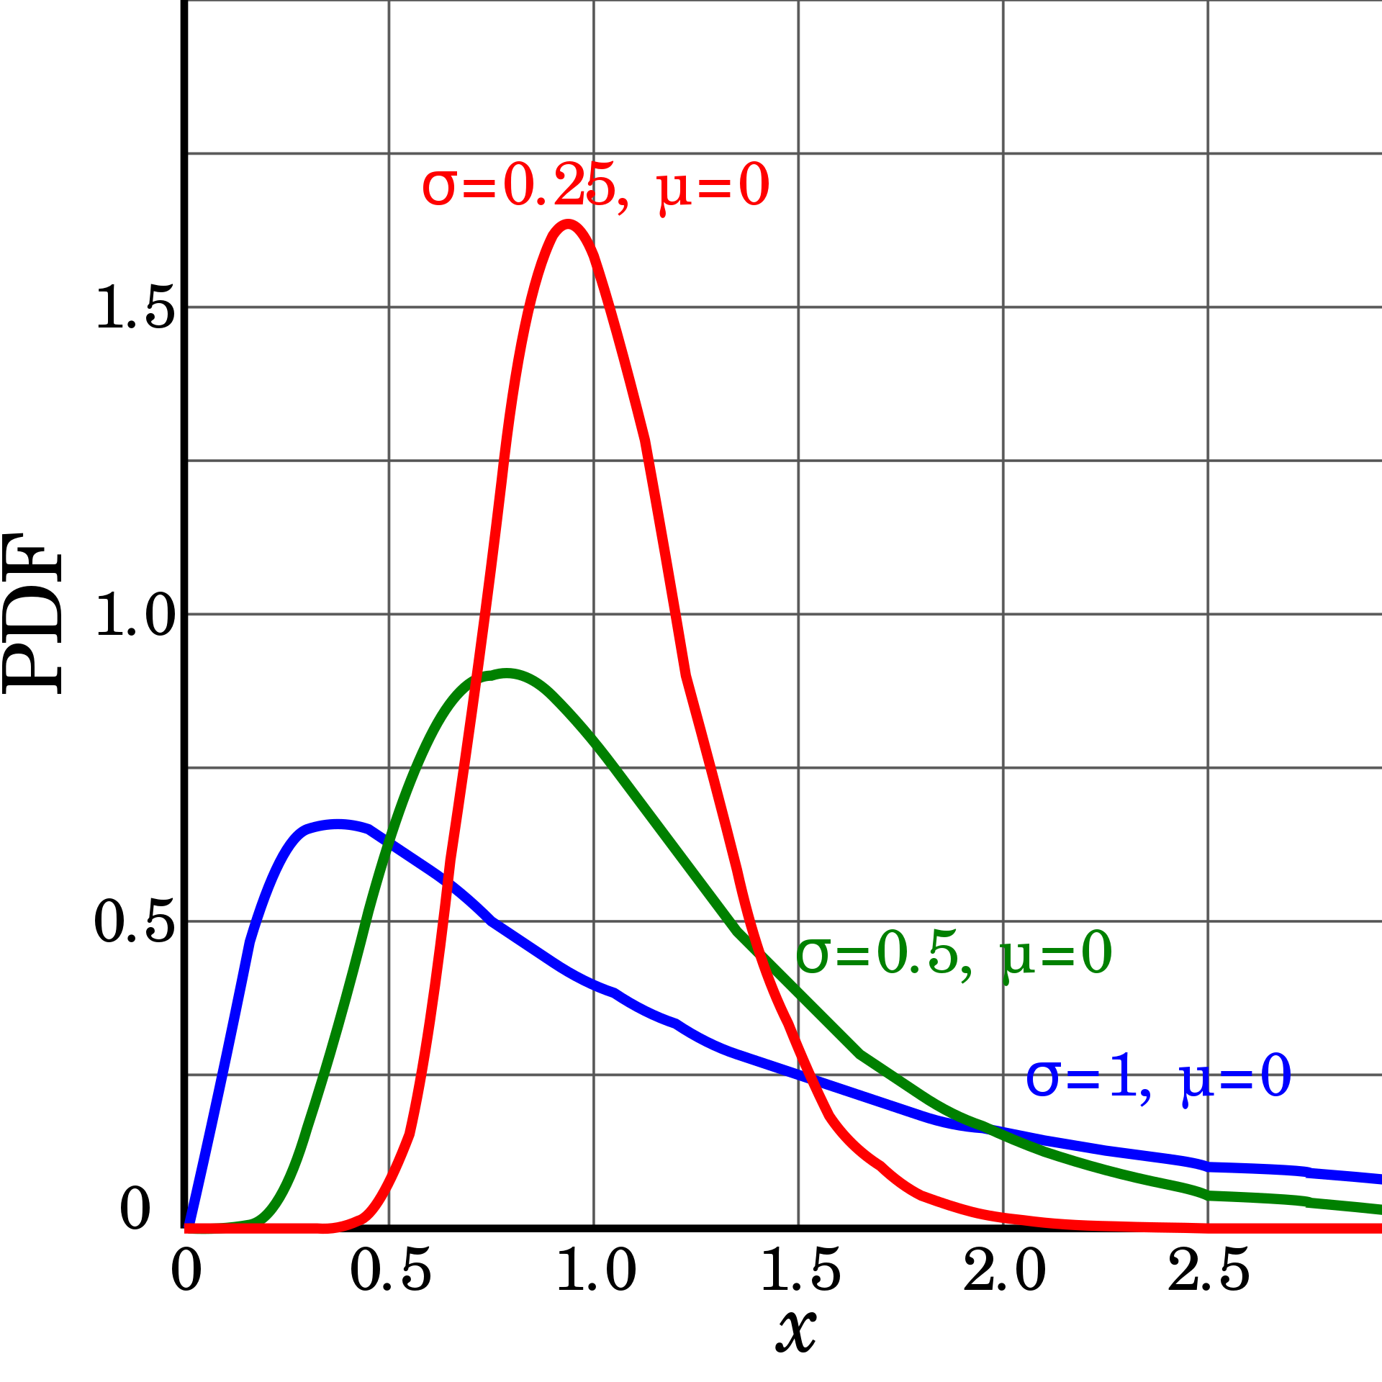
Log-normal distribution
A random variable X has a lognormal distribution if Z=ln(X) is normally distributed.
Hence, X takes only positive values.
Distribution is skewed right (long right tail).
Used to model multiplicative processes, such as growth of a population and file sizes in internet.

